Slide 1
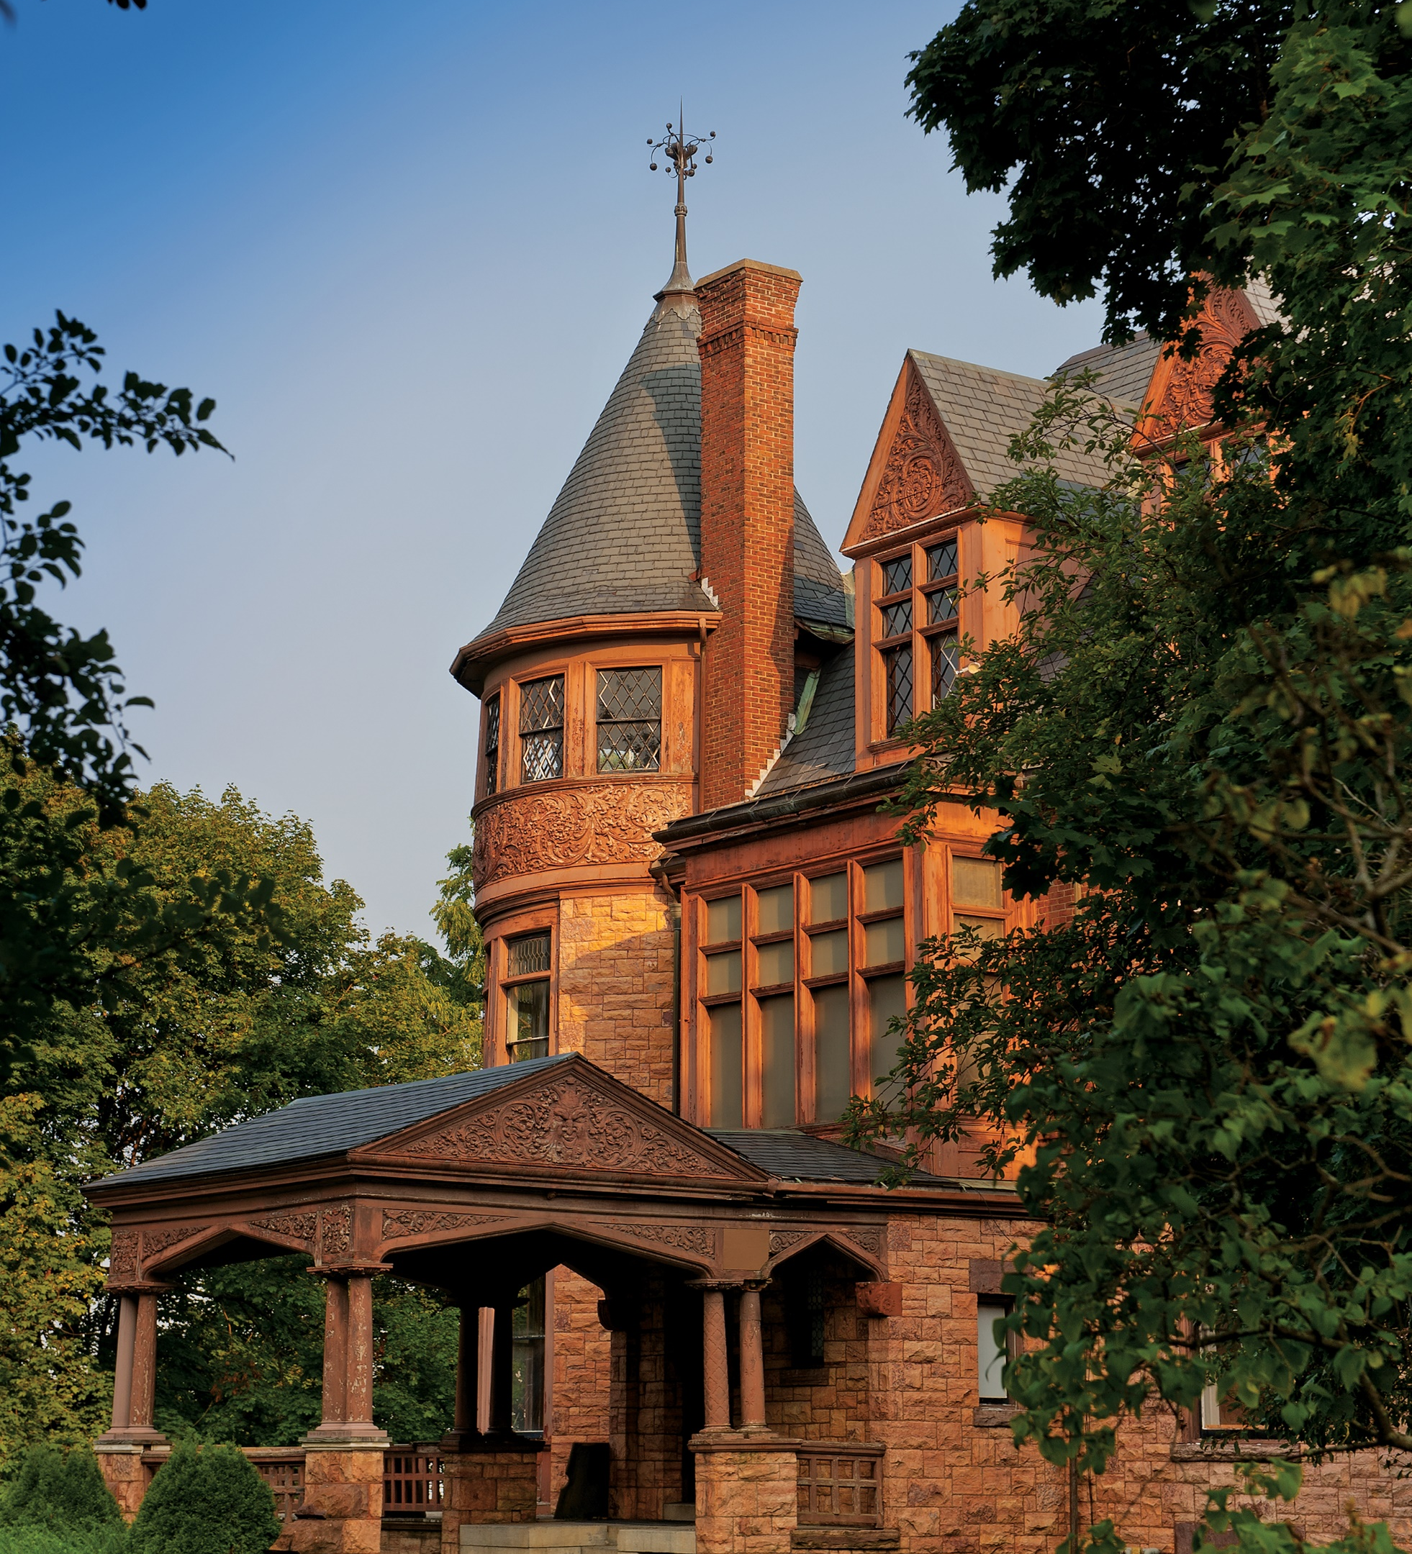
Welcome to the UVM Admissions Volunteer Information Session!
We will begin shortly…
Notes:
Opening slide while we wait for the program to start (6:50 to 7pm)

Slide 2
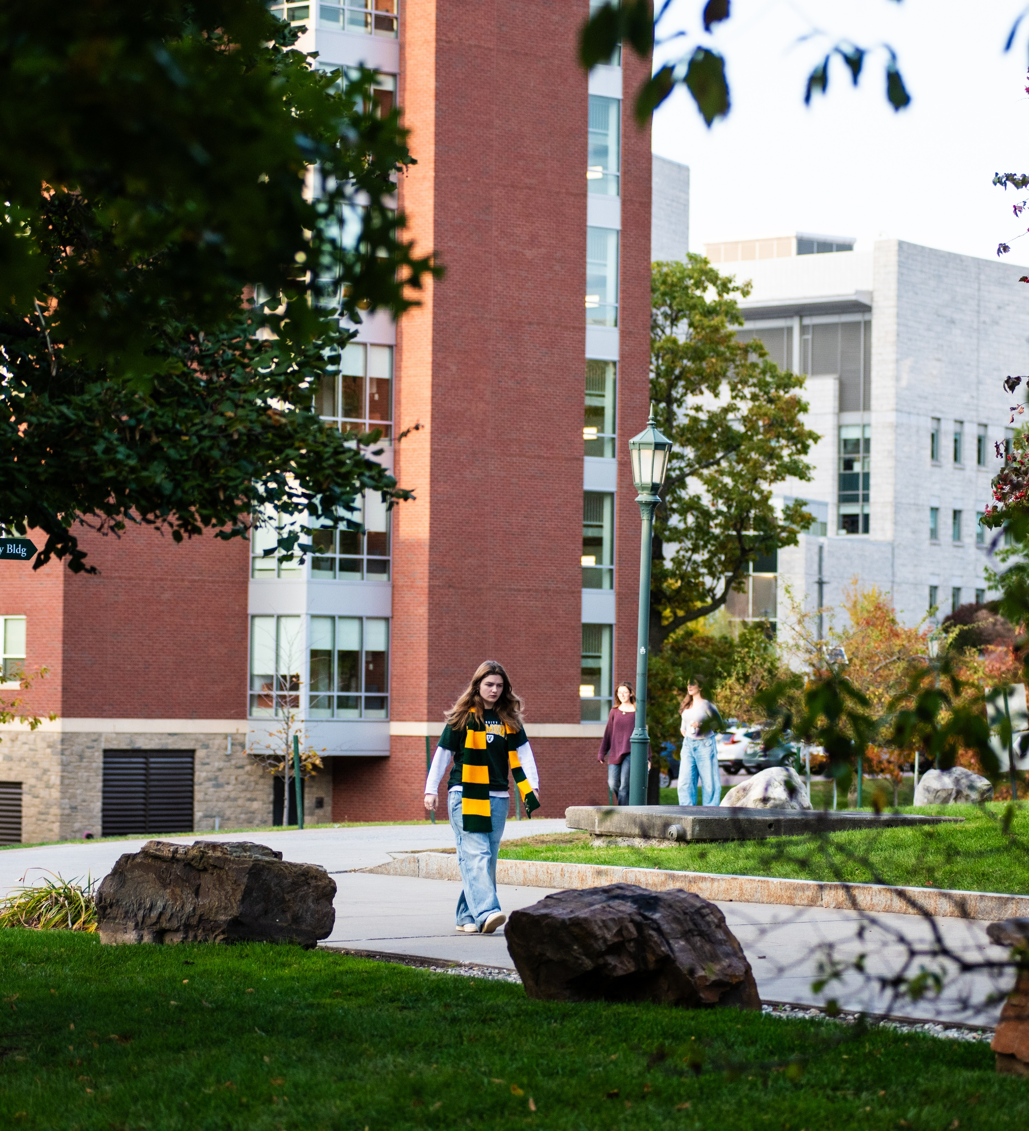
Welcome & What we’ll cover
Trends/Class of 2026
Application & Scholarship updates
Housing/student life updates for 2027
Safety
Current Student panel
What’s next?
Q&A
Notes:
Liz shares the overview of tonight’s time—notifies everyone we’ll be recording (Anja hits record),
Liz thanks all for being here. First off, asks Andrea, Anja and Moses in this order, to introduce themselves—students can come on later during panel for intros.
Moses begins with slide 3-

Slide 3
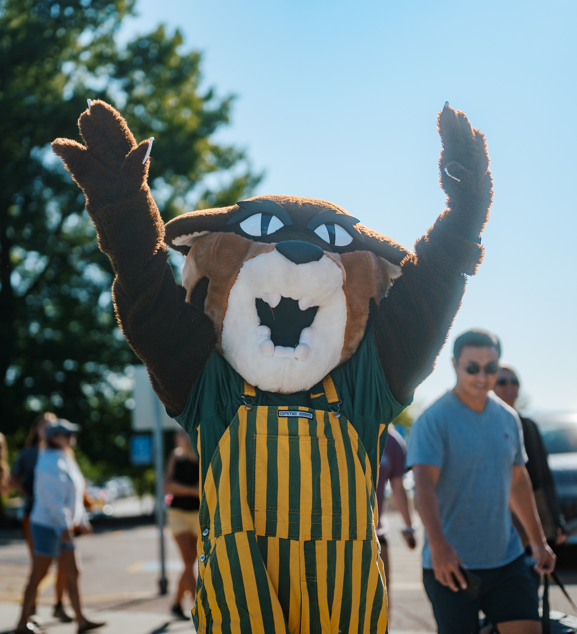
New Students Fall 2026 attributes
(unofficial until after census)
~2400 new first-time, first-year
~ 330 transfer students
50% outside of New England, 48 states, 38 countries
13% First-Generation
2nd most diverse in UVM history
2/3 participated in community service in HS
More than 50% of Vermont’s valedictorians
Notes:
Moses
This is where we are.
Share current demographic trends to set up the reasoning behind the next few slides.
Need the help of alumni to keep on the look out for talent

Slide 4

UVM Application process changes
No application fee for students to apply
No supplemental essays on application (Common Application essay remains)
UVM Visit Award for students who complete official visits by November 1of the senior year; $1000/yr & renewable for 4 years if enrolled
UVM Promise household threshold increased from $100,000 to $125,000 in adjusted gross income.
UVM gpa range is 3.5 to 3.8 and testing is still optional; less than half send scores. Use middle 50% ranges in recruitment materials for reference.
Notes:
Moses

Slide 5

Merit scholarship changes for 2027
Top academic merit scholarship increased to $30,000 for out of state and $15,000 for Vermonters
New transfer scholarship policy: Students who were initially admitted to UVM but chose to attend another institution will be eligible to receive their original first-year scholarship if they transfer to UVM before the start of their sophomore year.
Notes:
Moses

Slide 6
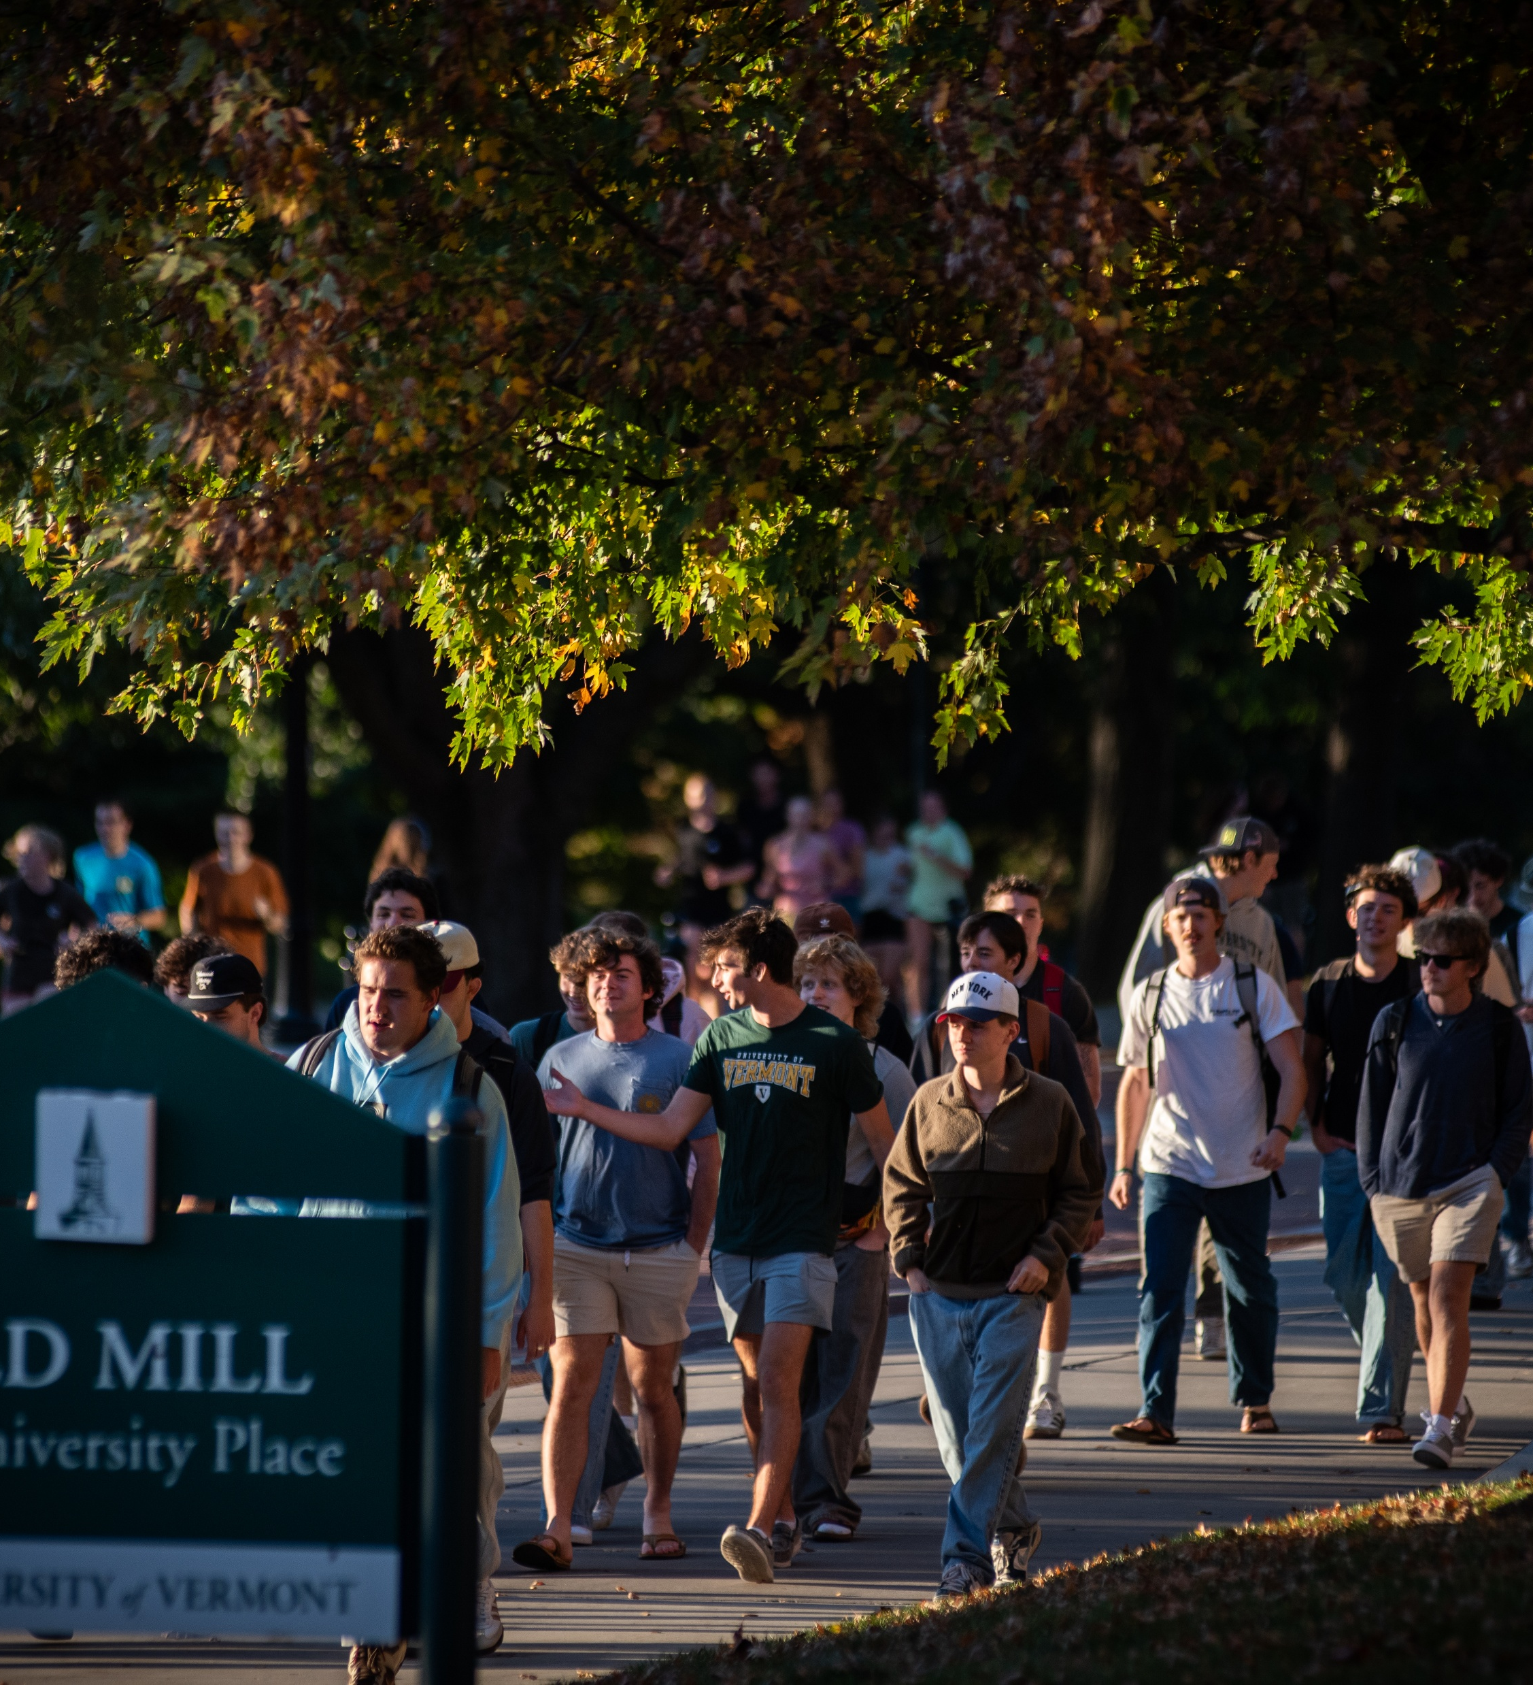
UVM’s Regional Tuition Break Program Changes for Fall 2027
New England Board of Higher Education (NEBHE) is for residents in CT, ME, NH, MA, and RI
Regional rate of tuition is 175% of in-state tuition
All majors in CESS, CALS and RSENR eligible
Student must remain in major and a resident to remain eligible
Merit and need-based aid will be determined using the applicable regional tuition rate
Tuition, participating programs and financial aid remain subject for annual review
Notes:
Moses

Slide 7
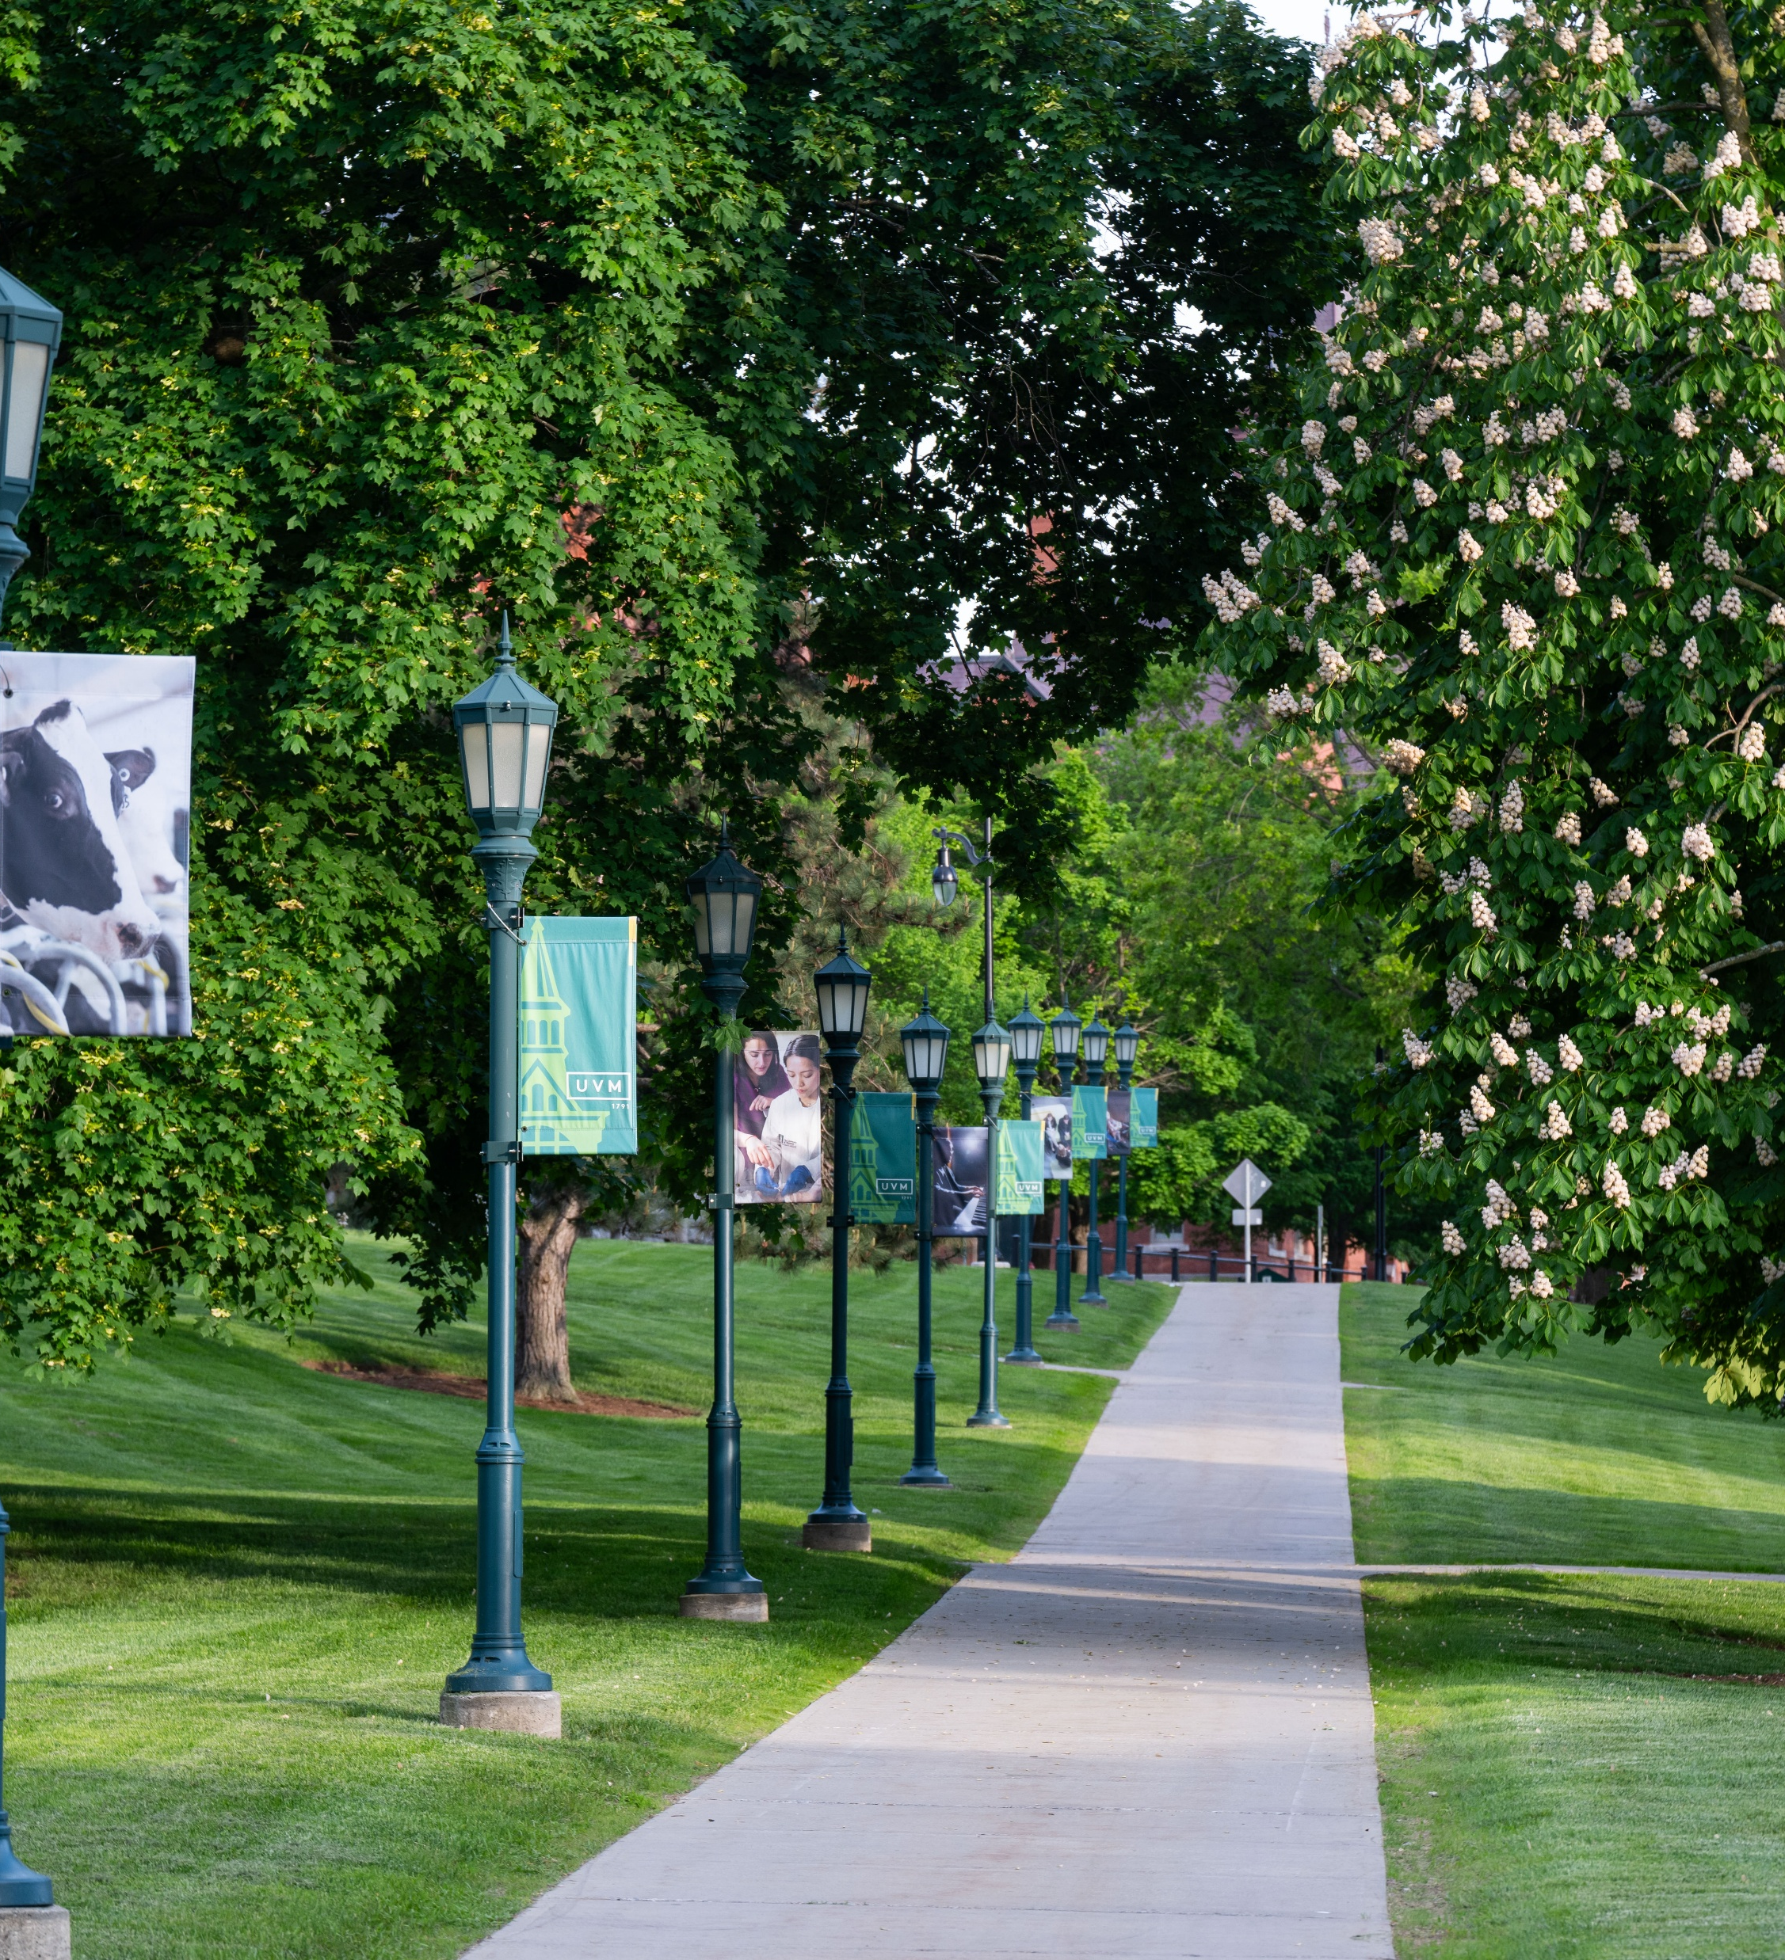
University housing/student life changes for Fall 2027
10% of FTFY students and 11% of total students living on campus live in triples. Most students are in doubles, singles and suites.
UVM on-campus and affiliated housing available to juniors and seniors
Ask UVM office opened in Davis Center (1-stop shop for guidance/direction)
Added Early Decision incentive: ED admits can enter lottery for 100 parking passes for FTFY
Notes:
Moses
Then send it to Anja

Slide 8
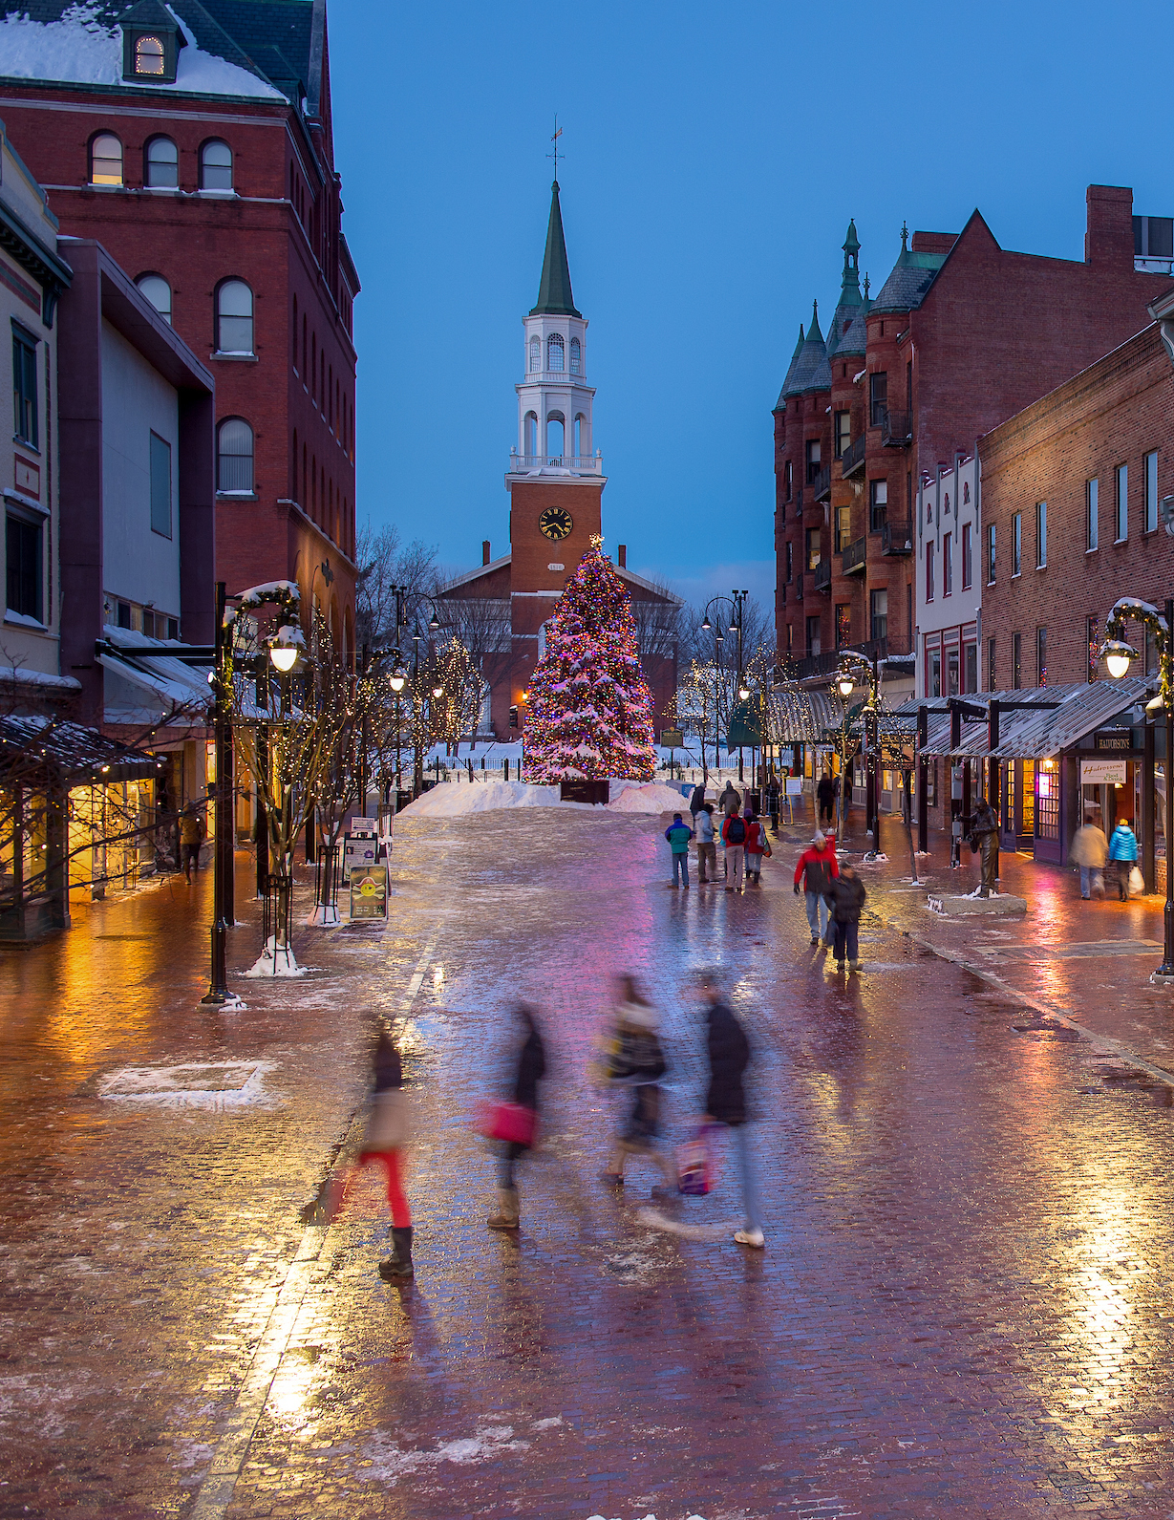
Safety in Burlington
In a recent study Burlington was ranked the 4th safest city in the US and South Burlington as the 1st
Burlington is NOT immune to national trends of housing issues, mental health challenges and drug activity – these issues exist here
Practicing vigilance reduces risks: lock doors, don’t leave valuables visible, and travel in pairs
“Nothing good happens after midnight”
With a little vigilance and the support of UVM’s safety resources, students can confidently navigate Burlington and thrive in our community.
Notes:
Anja—attended safety session
Add info about Safety week coming up

Slide 9
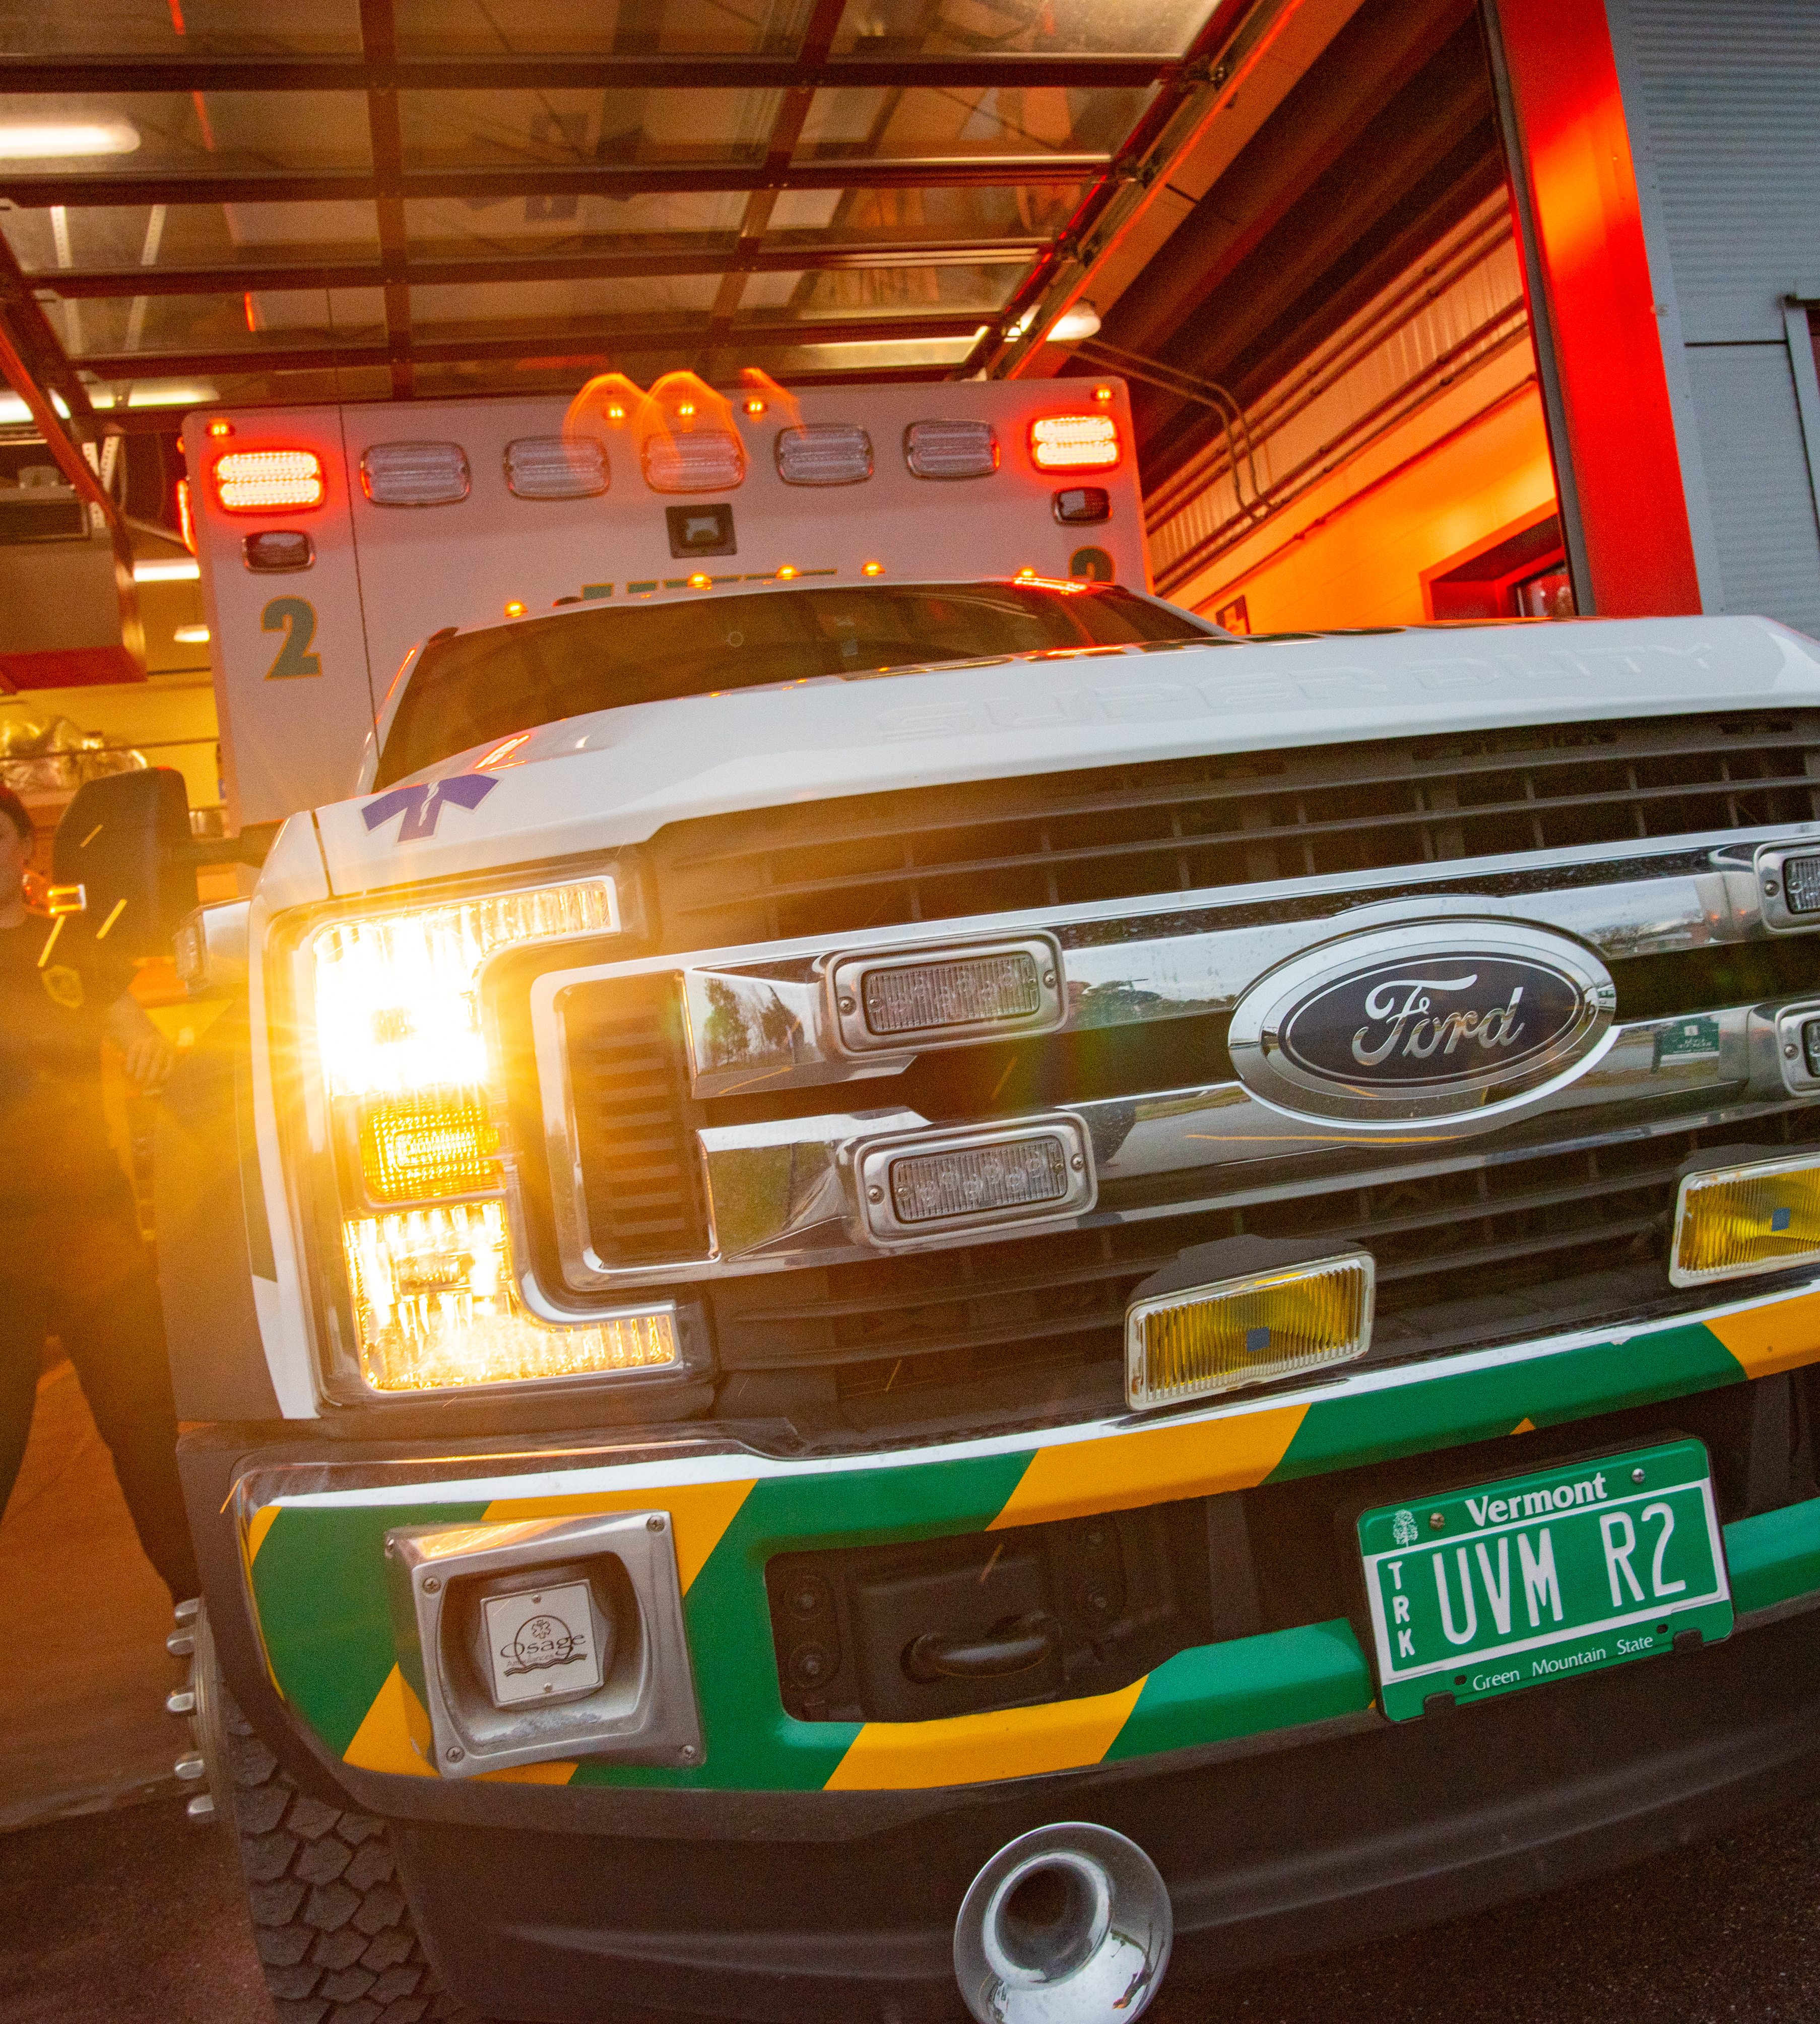
Cat ECare
Cat ECare program consists of lifesaving equipment at AED stations around campus.
Automated External Defibrillators (AEDs)
Bleeding control kits
Narcan® (Nasal opioid overdose treatment)
The program includes comprehensive training in CPR/AED use, bleeding control and Narcan.
See CATSafe for a map of AED locations.
Training: uvm.edu/emergency/cat-ecare-training
2,130+ individuals trained!
Notes:
Anja—more re
sources for students/leadership for students, beyond those in EMS club

Slide 10
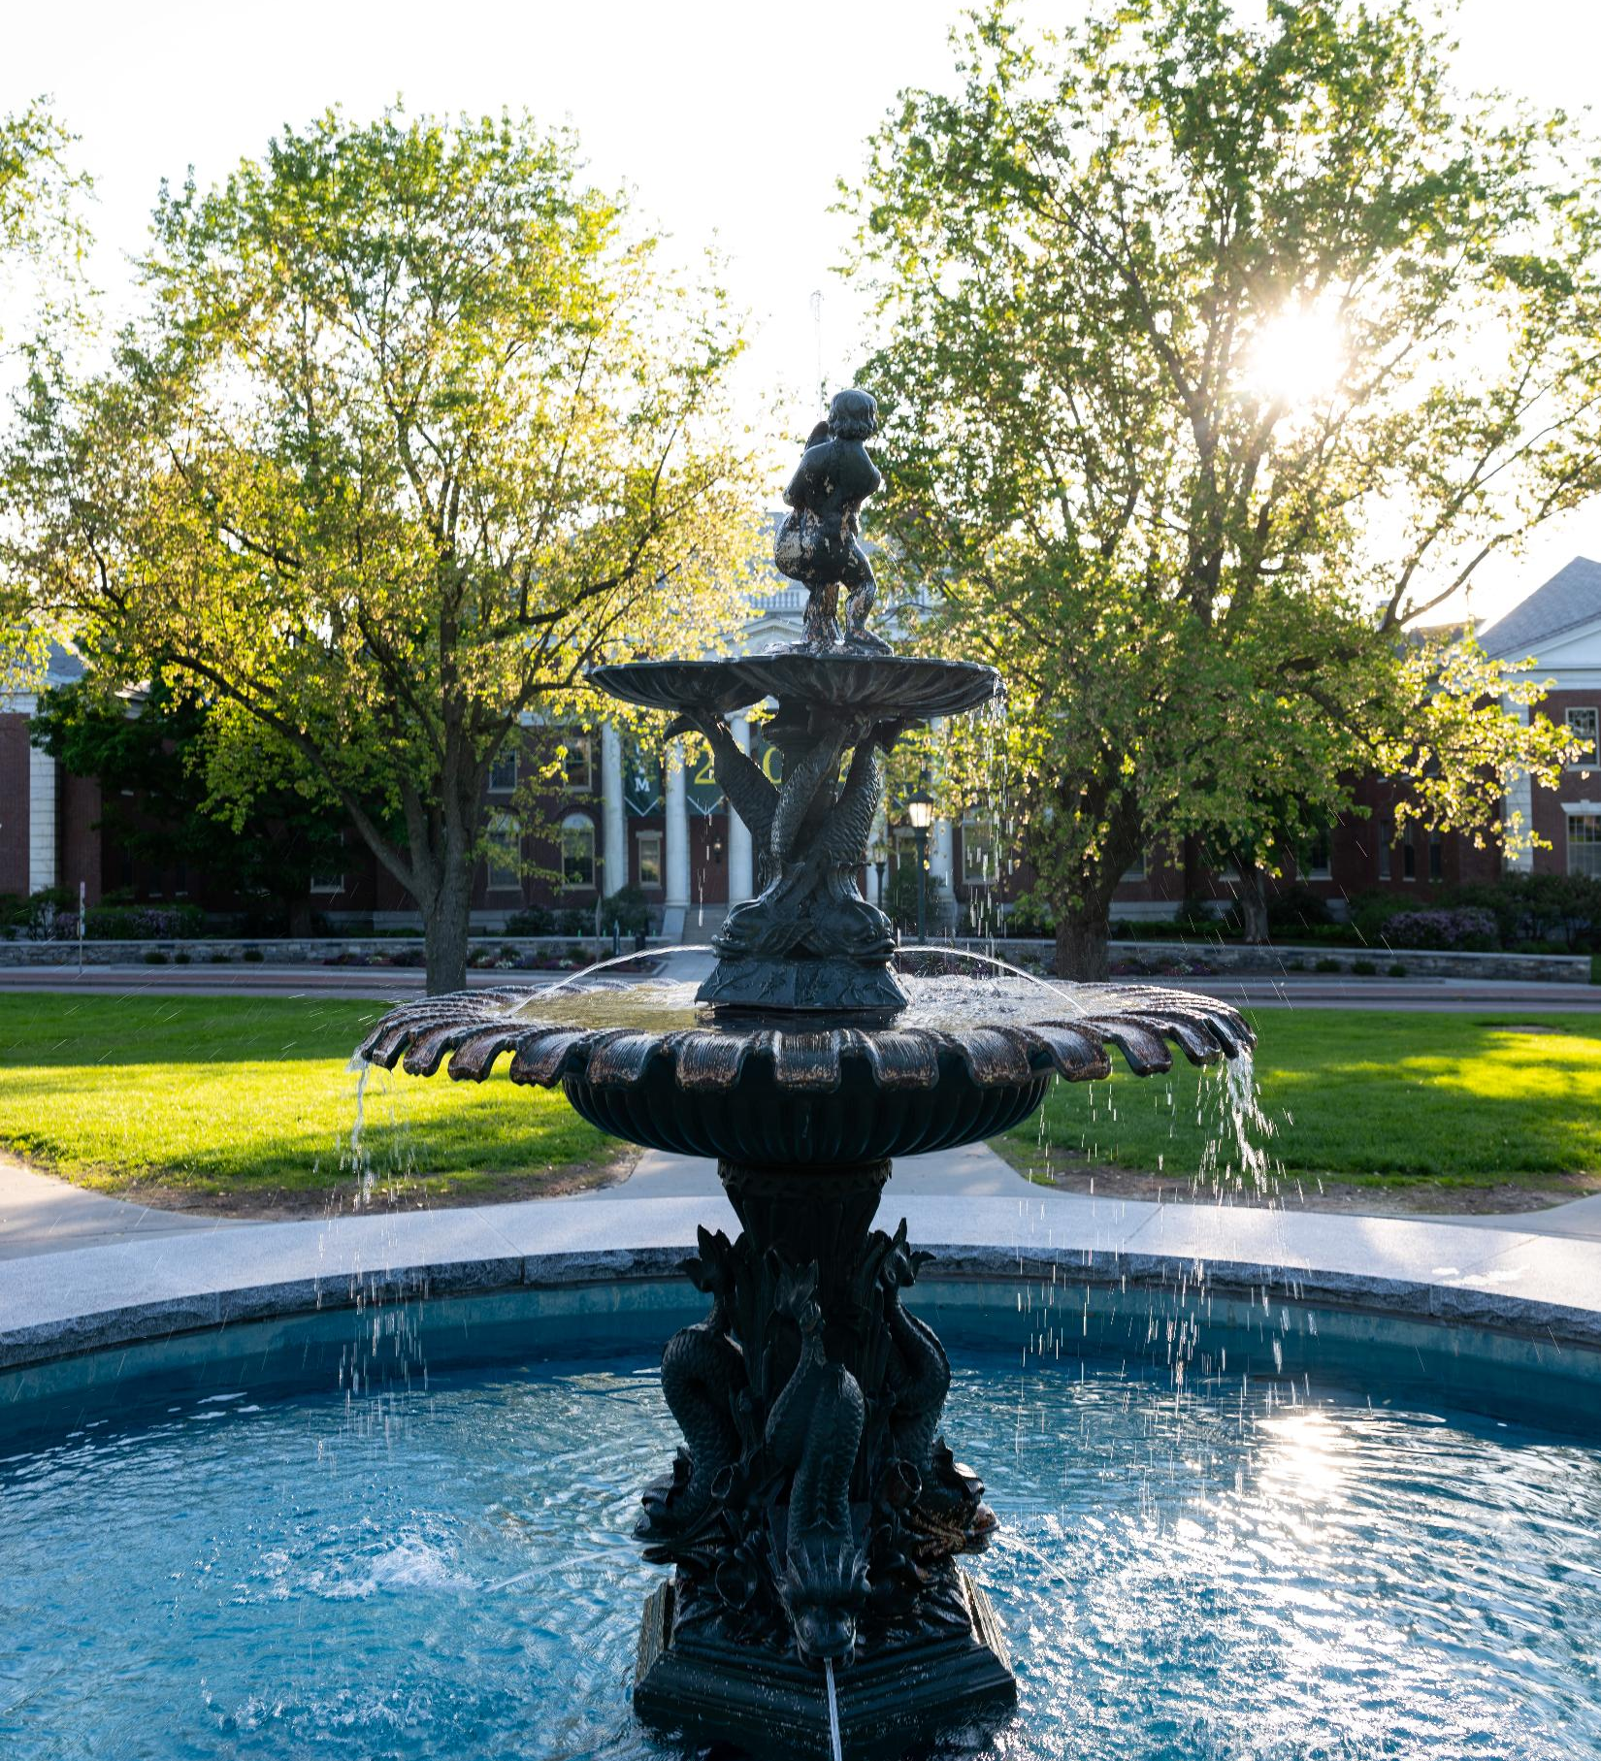
Rankings
#1 school for students who make an impact (Princeton Review)
#11 Top Green school (Princeton Review)
#68 in Top Public Schools (US News & World Report)
#10 on USA Today’s Best College Towns
#6 on CNN’s “America’s Best Towns to Visit”
Gold Rating awarded by Association for the Advancement of Sustainability in Higher Education for Sustainability for the fifth time in a row
#3 in Peace Corps volunteers
Notes:
Anja Things to get excited about –what folks are saying about UVM—
Send it on to Liz after you’re done

Slide 11
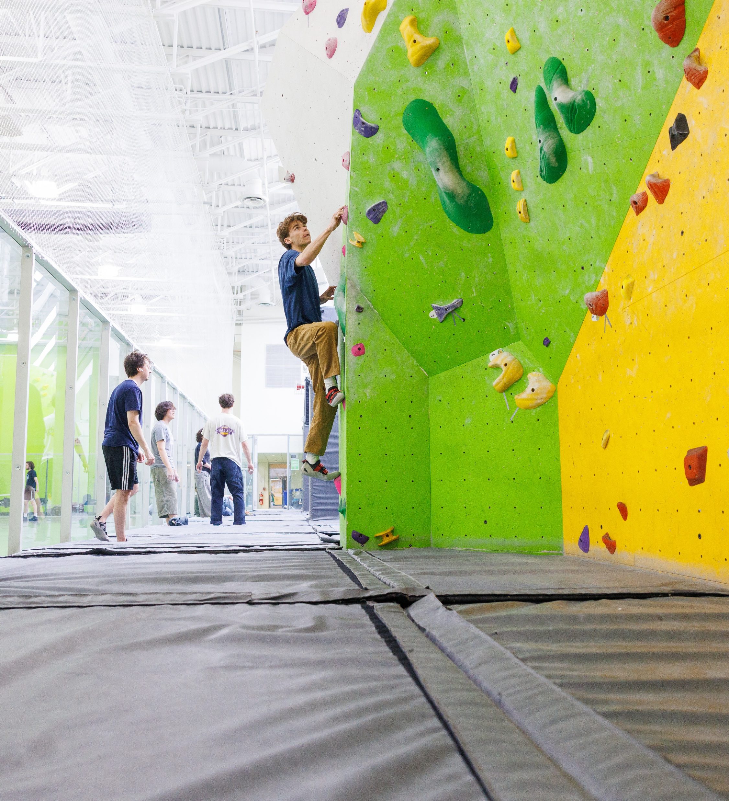
Current student panel
Abby Reeves ’28 Leawood, KS
Psychological Sciences
Eden Placer ’28 Franklin Lakes, NJ
Linguistics, minor in Communication Sciences and Disorders
Rese Schlameuss ’28 East Stroudsburg, PA
Political Science
Notes:
Liz to moderate panel (2 perspectives per question) Abby, Eden, Rese
Introductions by students,
Please story tell your:
Favorite class and/or interaction with faculty? What’s special about studying your major at UVM?
Tell us about the academic rigor and offerings you and your friends are experiencing?
How did you get involved on campus initially, how do you keep growing here?
What’s been the most impactful resources you use? Tutoring Center? CAPs, Career Center, Center for Health and Wellbeing, others?
What’s been your university housing experience? Living on campus, off campus, safety, and getting involved?
Any examples of advising, career, experiential learning you’ve been a part of and would help our alumni know what’s current?
What is one thing alumni volunteers can share with a prospective student about Why UVM today?
Thank you to our panelists…

Slide 12
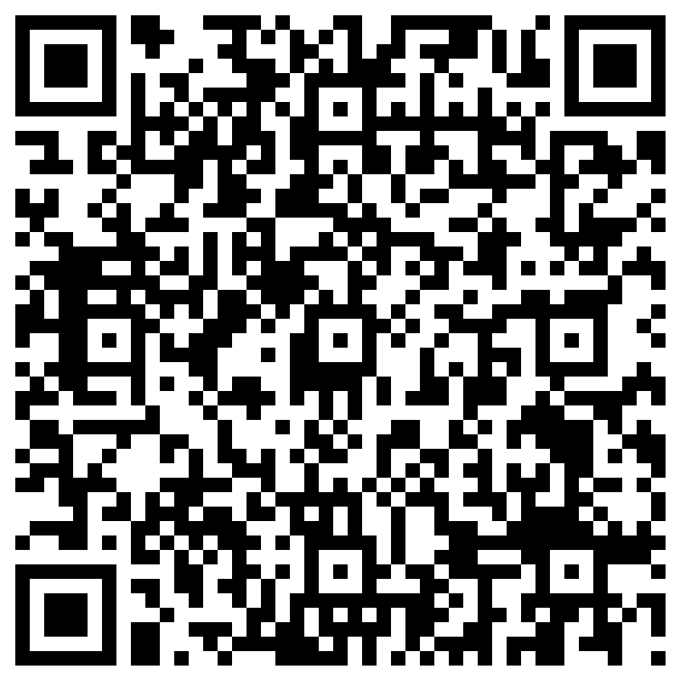
What’s next?
College fair coverage
Connect with admissions recruitment staff
Check that you’re receiving the monthly email updates
Fill the funnel: Refer a Catamount
Save the dates for Admitted Student Receptions
Feb 1-Washington, DC
Feb 2-Philadelphia, PA
Feb 3-New York City
March 16:
San Francisco
Chicago
Westchester County
March 17:
Denver
Minneapolis/St. Paul
Notes:
Liz
Refer a Catamount QR is feedback for what ideas you have that might incentivize alumni to refer a catamount…no longer having the application fee for the student as the incentive.

Slide 13
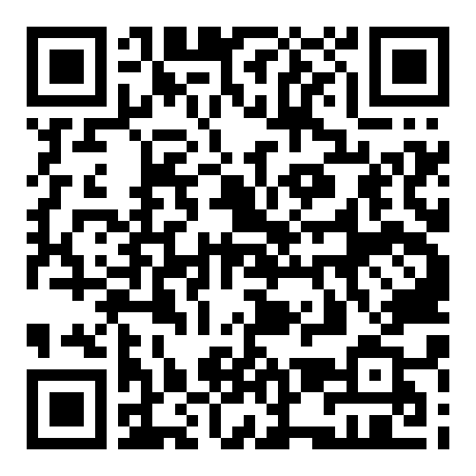
Thank you for joining us!
Questions?
Liz Hamlin-Volz G’14 – Elizabeth.Hamlin@uvm.edu
Anja Samsom ’24 Anja.Samsom@uvm.edu
Andrea Luchini ’98, G’05 Andrea.Luchini@uvm.edu
Moses Murphy Moses.Murphy@uvm.edu
Update your contact information!
Notes:
Liz back on screen. Anja stops recording.
Liz, Moses, Anja, Andrea back on screen and begin Q&A until 8pm…will take a few questions.

